Slide 1
Joints

Slide 2
Function of Joints
The site where two bones meet:
Provide support
To permit or decrease bone movement

Slide 3
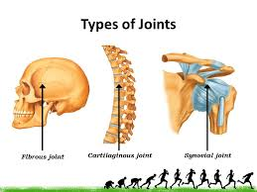
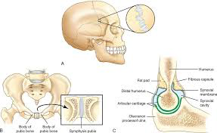
Types of Joints
Fibrous or fixed joint:
Allow no movement. Incredibly strong.
E.g. sutures/joints of the skull joints between the teeth and jaw

Slide 4
Types of Joints
Cartilaginous or slightly movable joints:
Allow limited movement.
E.g. intervertebral discs
joints of ribs and sternum

Slide 5
Types of Joints
Synovial or freely movable joints:
Allow large range of movements.
E.g. shoulder, elbow, hip, knee joint

Slide 6
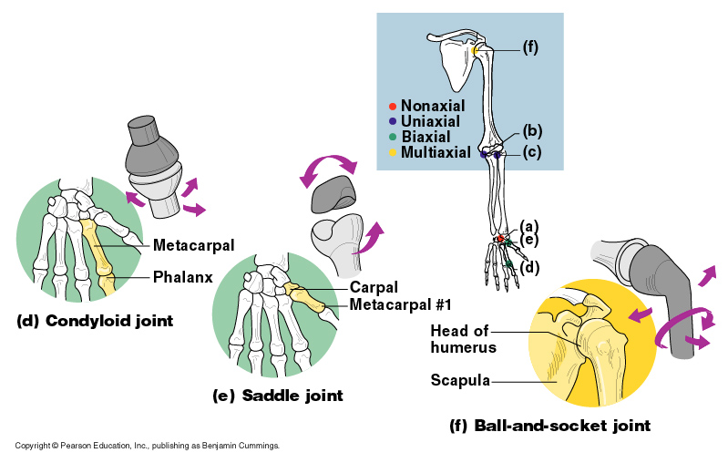
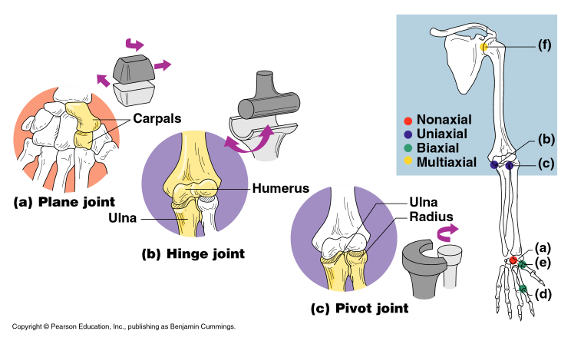
Types of Synovial Joints
Slide 5.52b

Slide 7
Ball-and-socket joints
Hinge joints
Pivot joints
Gliding joints
Saddle joints
Condyloid

Slide 8
Types of Synovial Joints Based on Shape –
https://www.youtube.com/watch?v=0cYal_hitz4
`

Slide 9
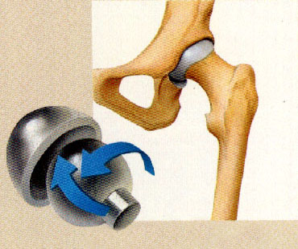
Ball and socket joints
These are formed when the spherical (rounded) head of one bone fits into a cup like cavity of another.
Allow a 360 range of motion called circumduction
E.g. shoulder joint and hip joint.

Slide 10
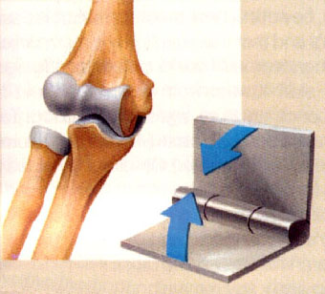
Hinge joints
A hinge joint allows movement in one plane only, just like a hinged door.
It is formed when the convex surface of one bone fits into the concave surface of another.
E.g. the elbow and the knee.

Slide 11
Imagine trying to catch a ball, walk, sit, lift a box, jump, run without these two joints What would it be like?

Slide 12
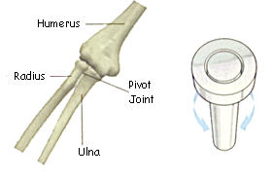
Pivot Joints: twist

Slide 13
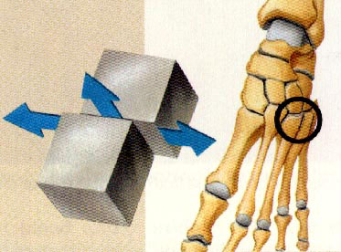
Gliding joints: side to side and back and forth

Slide 14
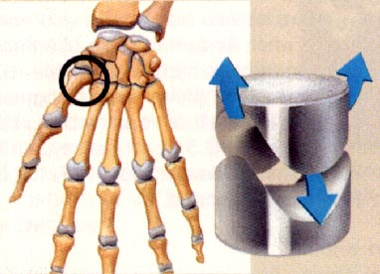
Saddle joints: side to side and back and forth

Slide 15
Condyloid joints: almost full rotation

Slide 16
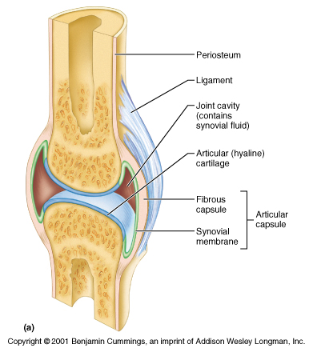
The Synovial Joint

Slide 17
Joint cavity: space between the two bones

Slide 18
Articular capsule: Surrounds cavity made of 2 membranes:
Fibrous capsule
Synovial membrane

Slide 19
Synovial fluid: removes debris, absorbs shock and reduce friction.

Slide 20
Articular cartilage: covers the articulating surfaces allowing for smooth movement

Slide 21
Some joints have bursae: little sacs of fluid.
Prevent friction between bone and ligament/tendon/skin.

Slide 22
They may also have an accessory ligament: holds the bones together and helps prevent dislocation.

Slide 23
Assessment 1: Research and validation
Bones, Joints, Injuries and Treatments

Slide 24
Sport Science –
https://www.youtube.com/watch?v=GvpgqT5vh6s

